Slide 1
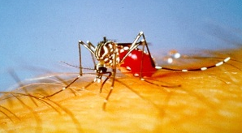
Management of Dengue in Bangladesh Perspective
Prof. Quazi Tarikul Islam
FCPS, FACP (USA), FRCP(Glasg), FRCP(Edin)
Professor of Medicine &
Team Leader
Tropical Disease Research Cell

Slide 2
Dengue Management at Different Level
Peripheral or Health Centers: We don’t have any report of dengue cases from rural area.
Secondary or District Level: There are few case reports form the district level, where doctors and health providers are already trained to treat the cases. Only complicated and severe cases are referred to tertiary care centers.

Slide 3
Dengue Management at Different Level
Most of the cases of dengue in Bangladesh are reported form the urban area.
More than 80% cases are confined in capital Dhaka.
In the capital, public and private hospitals are well oriented for managing dengue cases through regular training of doctors and other health professionals.

Slide 4
Notes:
8

Slide 5
MANAGEMENT OF DENGUE FEVER
Febrile Phase
Treatment is symptomatic and supportive
Rest
Paracetamol (not more than 4 times in 24 hours)
Do not give Aspirin or Brufen
Do not give any antibiotics
ORS- for moderate dehydration
Food should be according to appetite

Slide 6
MANAGEMENT OF DENGUE FEVER
Afebrile Phase
It is transient period from where recovery starts
Duration – 2 to 3 days after febrile stage
MANAGEMENT
Bed rest
Check platelet / haematocrit
Oral fluids
* Patient is advised to inform Platelet count and Hct report to Physician through SMS.

Slide 7
All patients should be observed carefully after febrile phase for at least 3 days
Patients and attendant should be informed about following danger signs
Abdominal pain
Passage of black stools
Bleeding into the skin
Bleeding from the nose and ….gums
Sweating
Cold skin
Sub conjunctival ….haemorrhage

Slide 8
IF ANY OF THESE SIGNS IS NOTICED THE PATIENT SHOULD BE TAKEN TO THE HOSPITAL

Slide 9
MANAGEMENT OF DENGUE FEVER
Convalescence Phase
Duration 7-10 days after critical phase
MANAGEMENT
No special advice
No restriction
Normal diet

Slide 10
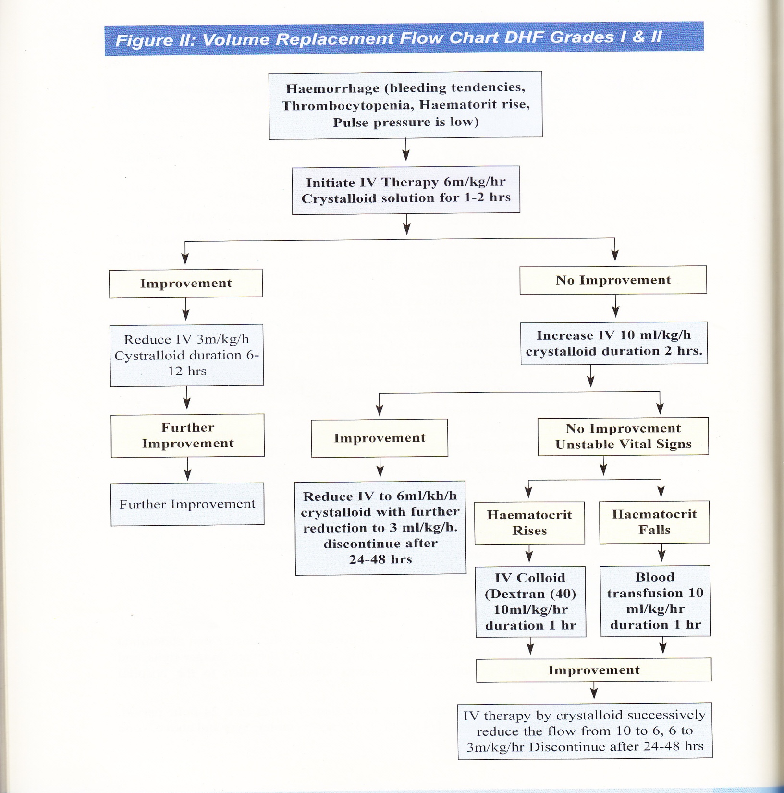
Notes:
8

Slide 11
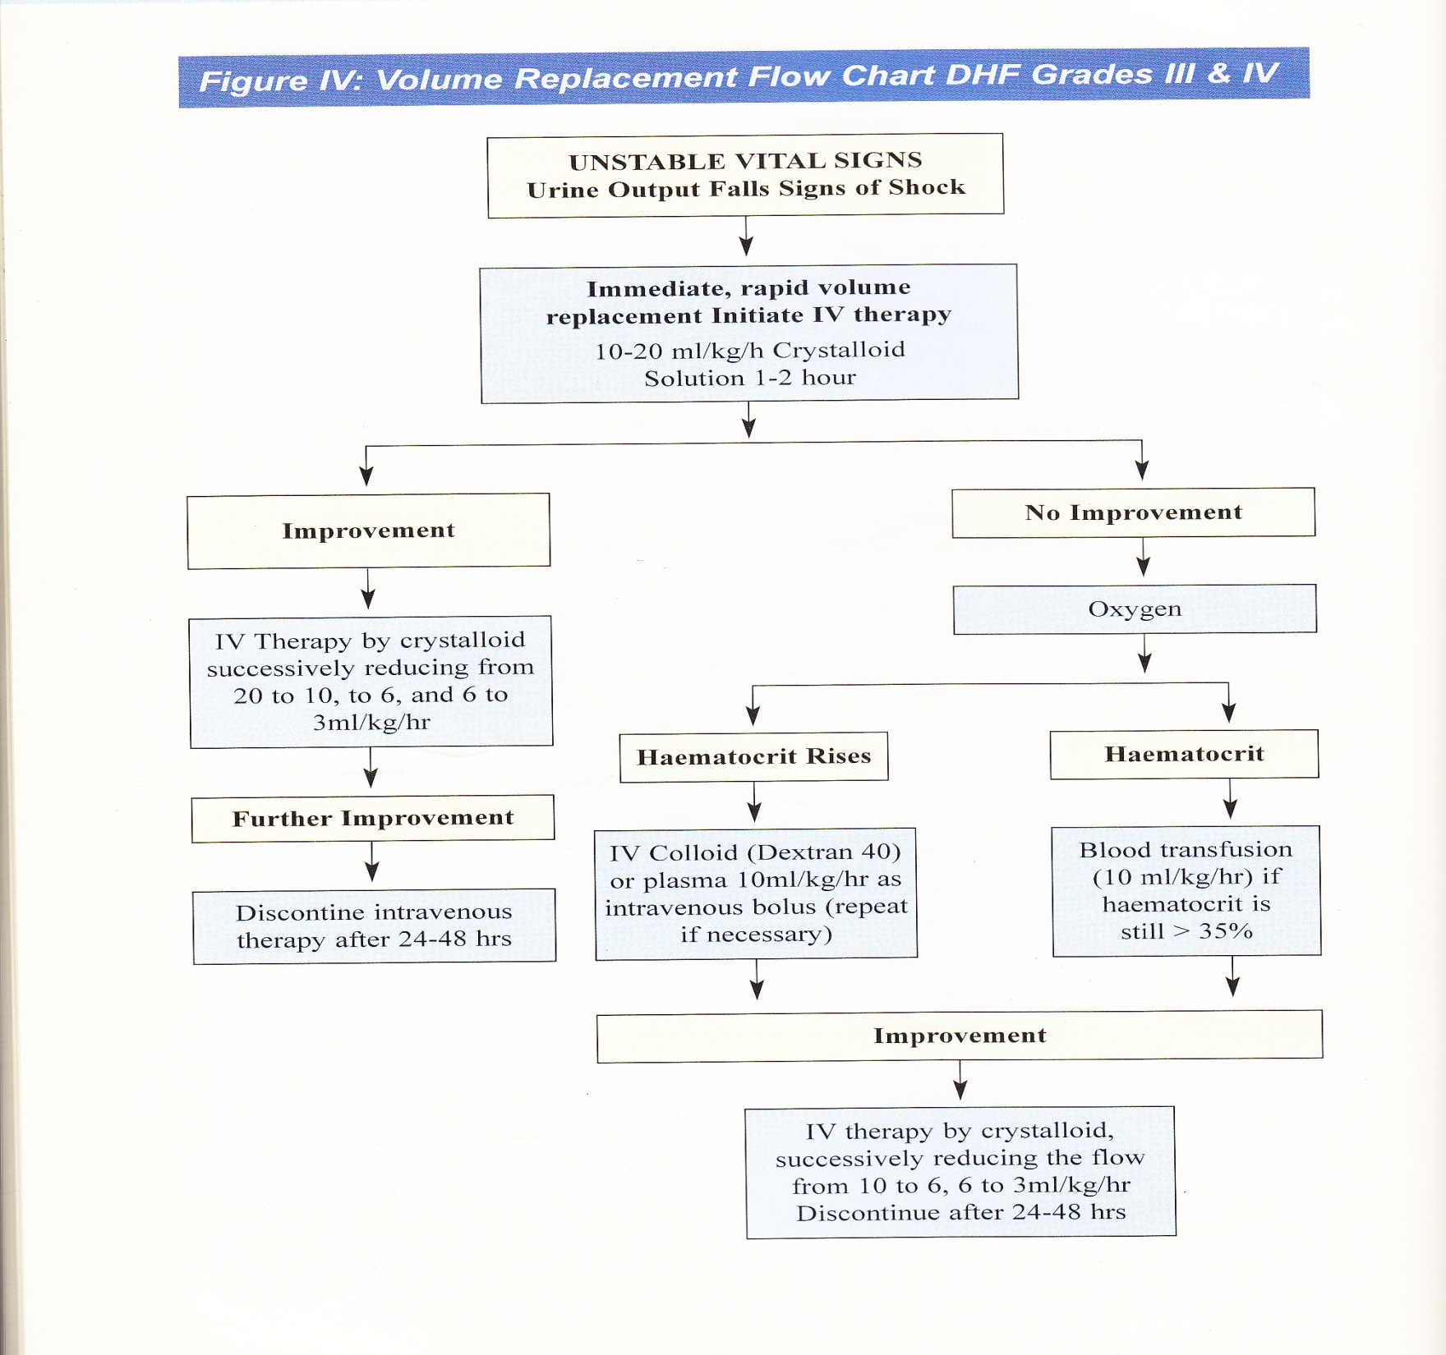

Slide 12
Target of Management
The DS entities are self-limiting condition. So the targets are:
 DF: To maintain nutrition and fluid electrolyte balance,
contain fever to tolerable range and prevent complications.
 DHF: In addition to provide supportive care invivo volume
state.
 DSS: In addition to maintain hemodynamic status and
measures for complications.
 The over all targets are to prevent the case fatality and
reduce the morbidity.

Slide 13
Home Management
Most of the DS can be managed at home or out patient settings even with very simple measures and there by serious complications can be avoided.

Slide 14
Hospital Management
Usually critically ill or panic-stricken patients will seek admission at hospital. The following sequences can be applied:
 Assessment of the patient
 DS or other condition
 Hemodynamic status
 Hemorrhagic state
 Complications
 Relevant investigations
 Initiations and maintenance of treatment
 Rehabilitation

Slide 15
Therapeutic options and tools
The following therapeutic options and tools are necessary for managing DS cases:
 Paracetamol
 Orsaline
 Fresh fruit juice
 Fluids:
Crystalloids - 5% DNS, NS, DRL
Colloids - Hemaccel, Plasma, Dextran
 Initiations and maintenance of treatment
 Rehabilitation

Slide 16
Febrile Phase:
1. Rest
2. Antipyretic therapy for fever above 39°C.
(a) Sponging: With tap water at room temperature.
(b) Paracetamol.
3. Aspirin should be avoided.
4. Don’t give antibiotic as this do not help.
5. Oral rehydation therapy (ORT).
6. Food should be given according to appetite. But
fresh fruit juice should be given frequently.
7. Carefully monitoring.

Slide 17
Afebrile Phase:
In this phase most of the patient recover with out any complication. But it can be also the most vital phase as the plasma leakage and hemodynamic instability can happen at this stage. The following features may be present:
• Improved in general condition.
• Platelet and Hematocrit level become normal.
• Appetite rapidly regained.

Slide 18
Convalescent Phase:
• Duration is 7-10 days after Afebrile phase.
• No special advice.
• No restriction.
Indication of Hospitalization:
DF cases and DHF Grade-I: If monitoring and observation not possible or presence of concomitant illness.
2. DHF Grade II, III and IV.

Slide 19
Signs of Recovery:
1. Stable pulse, blood pressure and breathing rate.
2. Normal temperature.
3. No evidence of external or internal bleeding.
4. Return of appetite.
5. Good urinary output.
6. Stable hematocrit.
7. Convalescent stable petechial rash.

Slide 20
Criteria for Discharging Patients:
1. Absence of fever for at least 24 hours without the
use of anti-fever therapy.
2. Return of appetite.
3. Visible clinical improvement.
4. Good urine output.
5. Minimum three days after recovery from shock.
6. No respiratory distress from pleural effusion and
no ascitis.
7. Platelet count of more than 50,000/mm3.

Slide 21
What should not be done is as important as
what should be done
What should be done should not be over done.
Please note that DF and DHF are self-limiting conditions, so one has to provide just therapeutic and other supportive care to prevent complication.

Slide 22
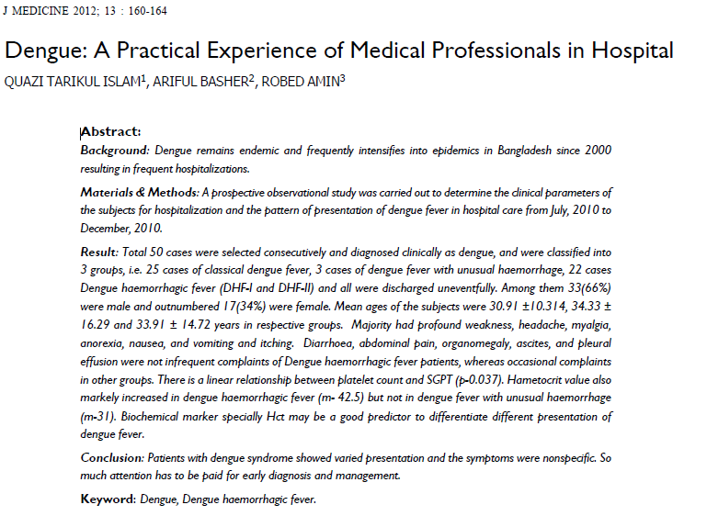

Slide 23
Dengue: A Practical Experience of Medical Professionals in Hospital
Result:
Total 50 cases were selected consecutively and diagnosed clinically as dengue, and were classified into 3 groups, i.e. 25 cases of classical dengue fever, 3 cases of dengue fever with unusual haemorrhage, 22 cases Dengue haemorrhagic fever (DHF-I and DHF-II) and all were discharged uneventfully.
Among them 33(66%) were male and outnumbered 17(34%) were female.
Mean ages of the subjects were 30.91 ±10.314, 34.33 ± 16.29 and 33.91 ± 14.72 years in respective groups.
Majority had profound weakness, headache, myalgia, anorexia, nausea, and vomiting and itching.

Slide 24
Dengue: A Practical Experience of Medical Professionals in Hospital
Diarrhoea, abdominal pain, organomegaly, ascites, and pleural effusion were not infrequent complaints of Dengue haemorrhagic fever patients, whereas occasional complaints in other groups.
There is a linear relationship between platelet count and SGOT (p-0.037).
Hametocrit value also markely increased in dengue haemorrhagic fever (m- 42.5) but not in dengue fever with unusual haemorrhage (m-31).
Biochemical marker and Hct may be a good predictor to differentiate different presentation of dengue fever.

Slide 25
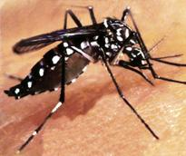
WE HAVE TO LIVE WITH IT

